Slide 1
EC504 Project Presentation
Performance Comparison between red-Black Tree and AVL Tree
Ziyan Chen
Hin Lui Shum
Jìa Wilkins
Zhiqing Wang

Slide 2
Project Objectives
Tree Algorithms and Applications
Main Objective:
Analyze different tree structures and compare their performance.

Slide 3
Contents
Contents
AVL Tree
B+ Tree
Red-Black Tree (RBT)
1, Establishment
2, Properties
3, Insertion and Deletion
Similarities and Difference Between AVL and RBT
Efficiency comparisons

Slide 4
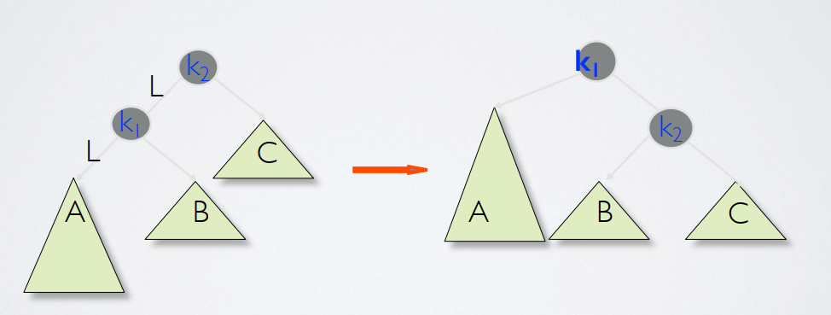
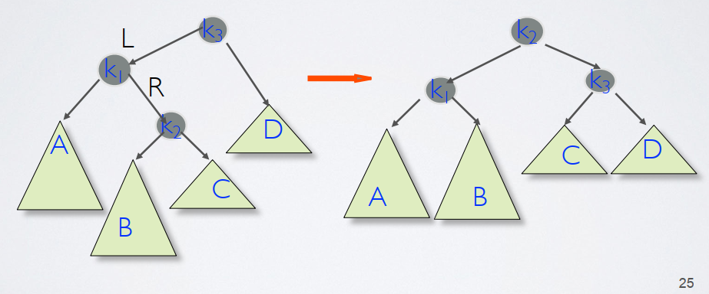
AVL (Andelsen-Valsky and Landis Tree )
AVL ( Andelsen-Valsky and Landis Tree, in memory of the three inventors) is the earliest balanced binary search tree (BST) structure in the world.
BST: K(left sub)<=K(root)<L(right sub) for every node (take it as a root)
Strictly balancing:
For every node, | h(left subtree) - h(right subtree)| <=1
If not, rotate subtrees to make it balanced. (LL, RR, LR, RL)
Learned much about it this semester, go over it quickly:
Figure 1: LL rotate
Figure 2: LR rotate

Slide 5
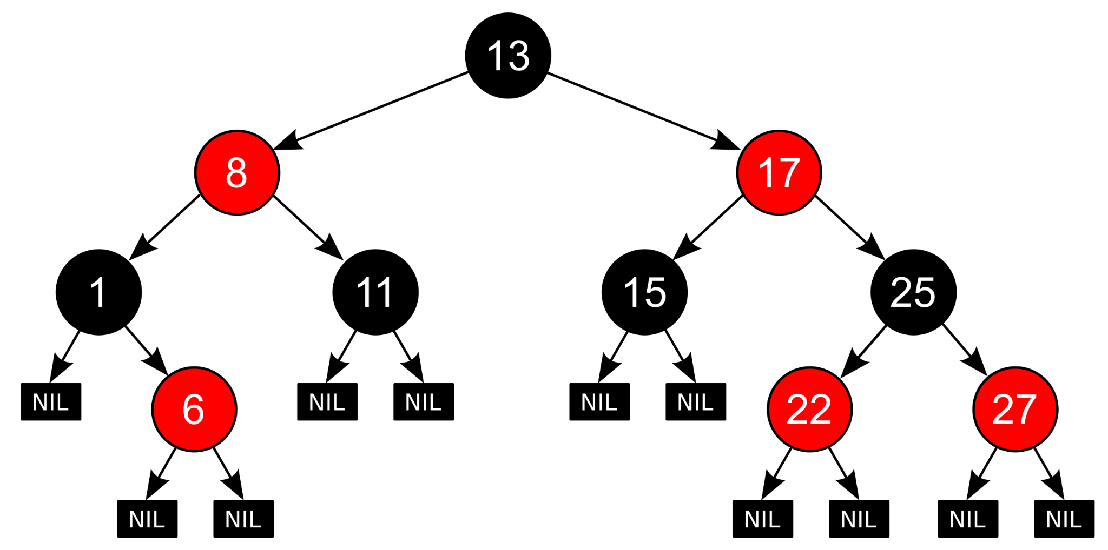
Red-Black Tree
Invented in 1978 by Leonidas J. Guibas and Robert Sedgewick
Holds nodes with colors: red and black
Not such strict like AVL, but good for performance

Slide 6
Establishment
Red-Black Tree
0. RBT should be a BST first!
Every node is red or black
All NIL nodes are black
red nodes don’t have red child ( so red node’s child must be black)
Every path from a given node to any of its descendant NIL nodes goes through the same number of black nodes.

Slide 7
Properties
Red-Black Tree
Root is black
(From 4) If a node N has exactly one child, it must be a red child, because if it were black, its NIL descendants would sit at a different black depth than N's NIL child, violating 4
(From 5) Every red node have 2 black children nodes
A RBT with n nodes has height no larger than 2 log_2(n+1）

Slide 8
Proof of 4
Red-Black Tree
Let’s proof this lemma first: for a node x, the subtree using x as root contains at least 2^(bh(x))-1 nodes, where bh(x) is the black height, meaning number of black nodes when travelling from x to any leaves. Using conclusion:
h(x)=0, x=NIL(leaf);
h(x)>0, consider x with 2 children, with each child’s black height bh(x) / bh(x)-1
Since h(x’s children)<h(x), from conclusion, we have every children tree have at least 2^(bh(x)-1)-1 nodes.
Then sub tree using x as root has at least (2^(bh(x)-1)-1)*2+1=2^(bh(x)-1)-1. Q.E.D.
Set tree’s height as h, then from 4, bh(root)>=h/2. So n>=2^(h/2)-1 ⇒ h<= 2log_2 (n+1). Q.E.D.

Slide 9
Properties
Red-Black Tree
Root is black
(From 4) If a node N has exactly one child, it must be a red child, because if it were black, its NIL descendants would sit at a different black depth than N's NIL child, violating 4
(From 5) Every red node have 2 black children nodes
A RBT with n nodes has height no larger than 2 log_2(n+1）

Slide 10
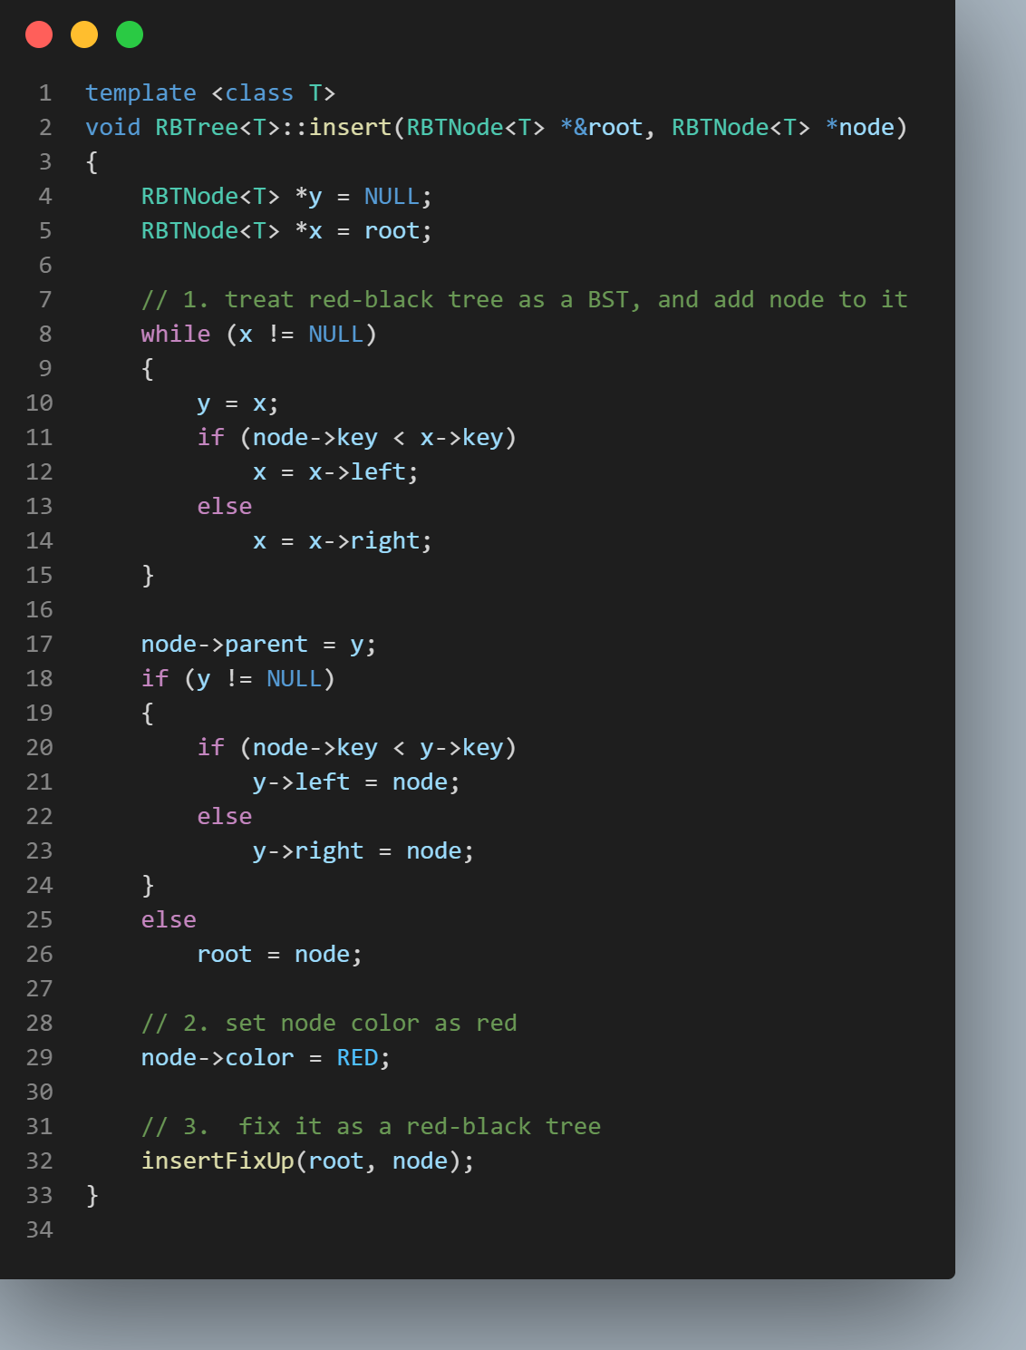
Insertion
Red-Black Tree
The first step is similar to BST,
but the hardest thing is how to fix the coloring
to make the tree corresponding to rule 1~4 again.

Slide 11
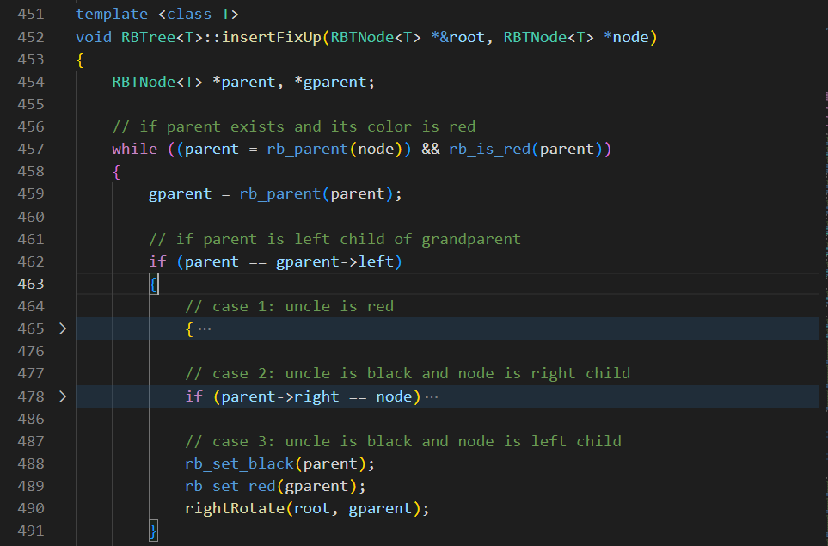
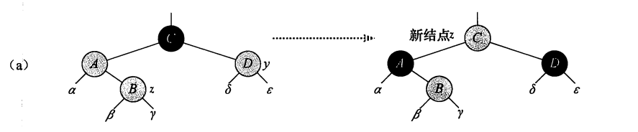
Insertion fixup
Red-Black Tree
if parent is left child of grandparent:
uncle is red uncle, parent, grandparent
uncle is black
node is right child swap (uncle, node)
~left~ parent , grandparent
~ right child ~

Slide 12
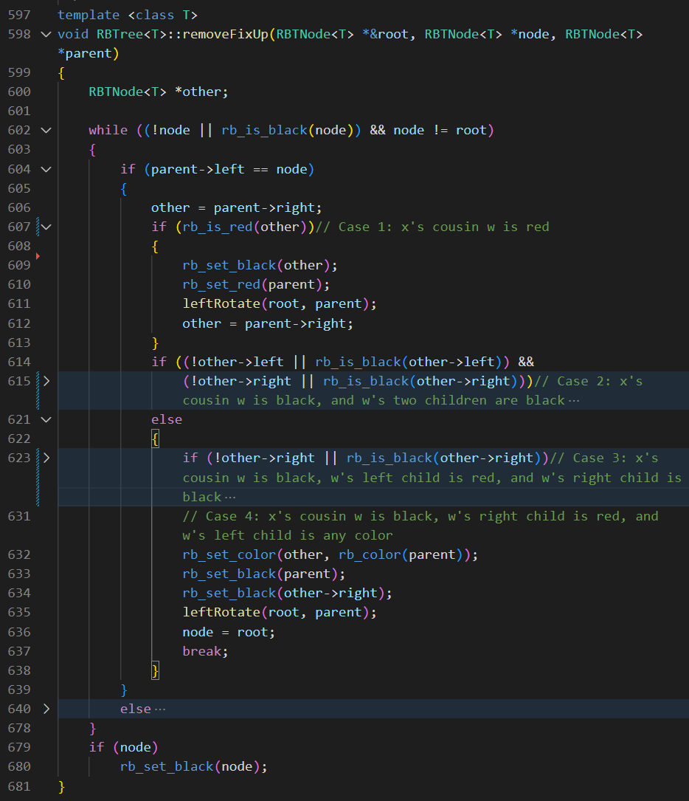
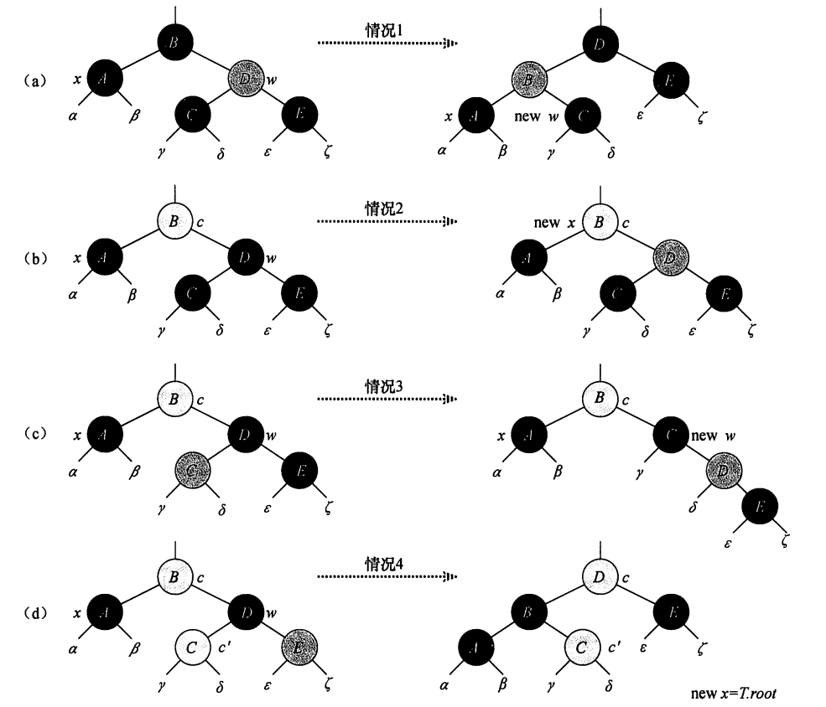
Deletion
Red-Black Tree
Similarly, after deletion ,we need a color fix to make it a RBT again

Slide 13
Similarities and Differences between AVL and RBT
Red-Black Tree and aVL
Similarities
Both are BSTs
Both need rotation to make itself balanced
Differences
RBT is not so strictly balanced as AVL
AVL’s strictness make every insertion/deletion violates its properties and need lots of rotation to fix it, while BST ensures less rotations to achieves it.
…which leads efficiency difference in frequent adjustment on the tree.

Slide 14
Testbench
Efficiency Comparison
[zychen02@scc1 zychen02]$ uname -a
Linux scc1 4.18.0-513.9.1.el8_9.x86_64 #1 SMP Sat Dec 2 05:23:44 EST 2023 x86_64 x86_64 x86_64 GNU/Linux
[zychen02@scc1 zychen02]$ cat /proc/cpuinfo|grep name|cut -f2 -d:|uniq -c
32 Intel(R) Xeon(R) Gold 6242 CPU @ 2.80GHz
[zychen02@scc1 zychen02]$ cat /proc/cpuinfo|grep "processor"|wc -l
32
[zychen02@scc1 zychen02]$ cat /proc/cpuinfo|grep "cores"|uniq
cpu cores : 16

Slide 15
Test method
Efficiency Comparison
In different scales of random data, compare the following aspects:
build tree
search a certain node
find node with max value
find node with min value

Slide 16
Result
Efficiency Comparison
Node Count | AVL_Build | AVL_Search | AVL_FindMin | AVL_FindMax | BST_Build | BST_Search | BST_FindMin | BST_FindMax
 | s | s | s | s | s | s | s | s
10 | 1.28E-06 | 1.69E-07 | 8.04E-08 | 8.01E-08 | 2.34E-06 | 1.02E-07 | 7.15E-08 | 7.77E-08
100 | 1.31E-05 | 8.24E-08 | 7.54E-08 | 7.84E-08 | 1.45E-05 | 8.93E-08 | 7.91E-08 | 8.09E-08
1000 | 0.00014 | 8.64E-08 | 7.93E-08 | 8.3E-08 | 0.000165 | 1.11E-07 | 8.59E-08 | 9.66E-08
10000 | 0.001963 | 1.08E-07 | 1.09E-07 | 9.9E-08 | 0.001995 | 1.39E-07 | 1.23E-07 | 1.37E-07
100000 | 0.033695 | 0.0000002 | 3.23E-07 | 1.53E-07 | 0.029312 | 3.09E-07 | 2.16E-07 | 3.13E-07
1000000 | 0.033028 | 2.38E-07 | 3.44E-07 | 1.66E-07 | 0.029569 | 2.76E-07 | 2.07E-07 | 2.93E-07
10000000 | 0.03395 | 2.68E-07 | 3.22E-07 | 3.22E-07 | 0.029716 | 2.64E-07 | 2.23E-07 | 2.92E-07

Slide 17
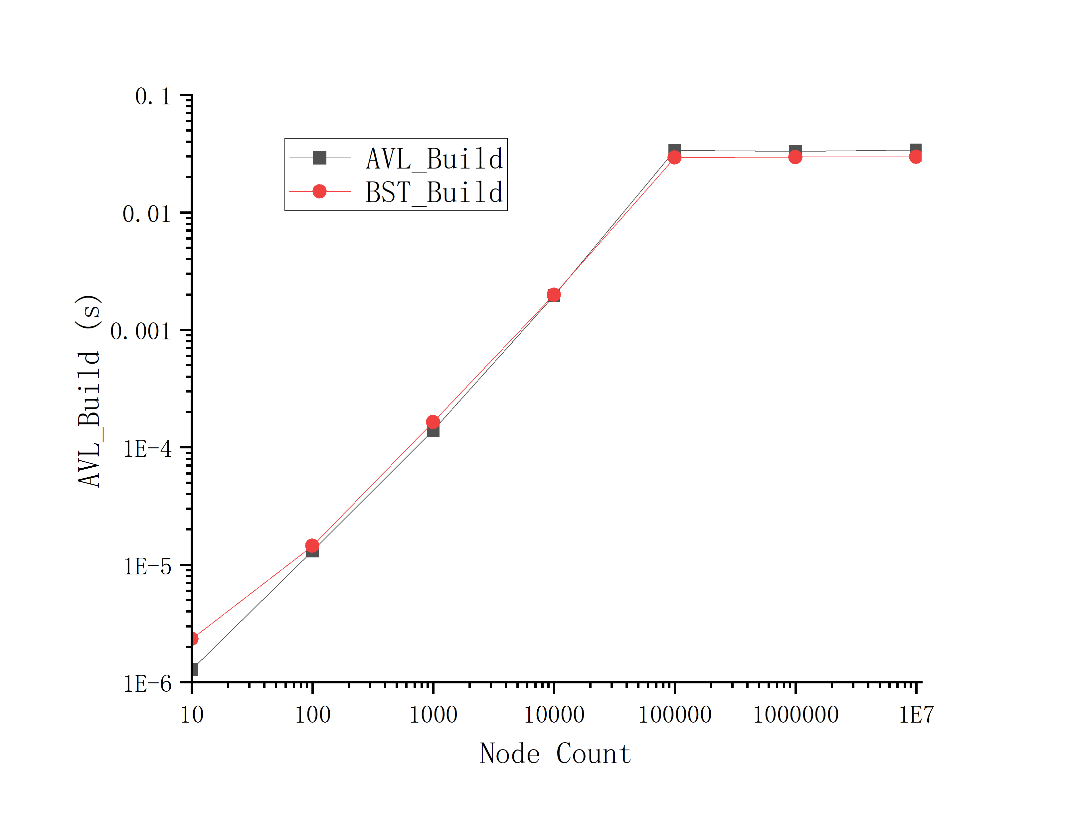
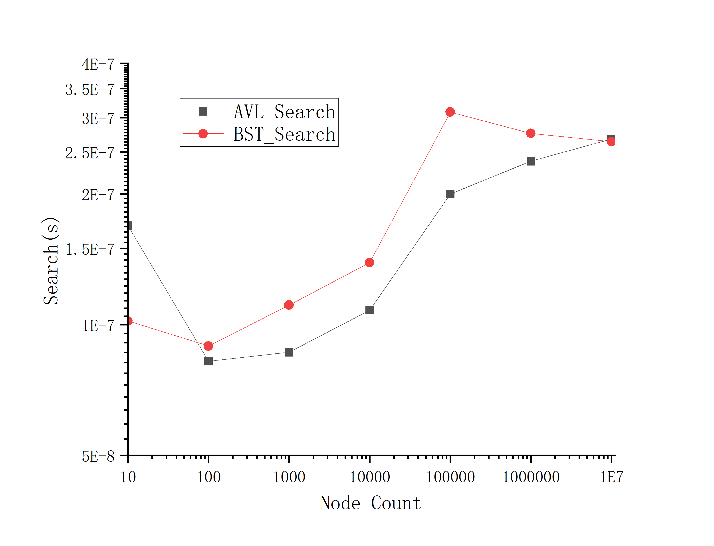
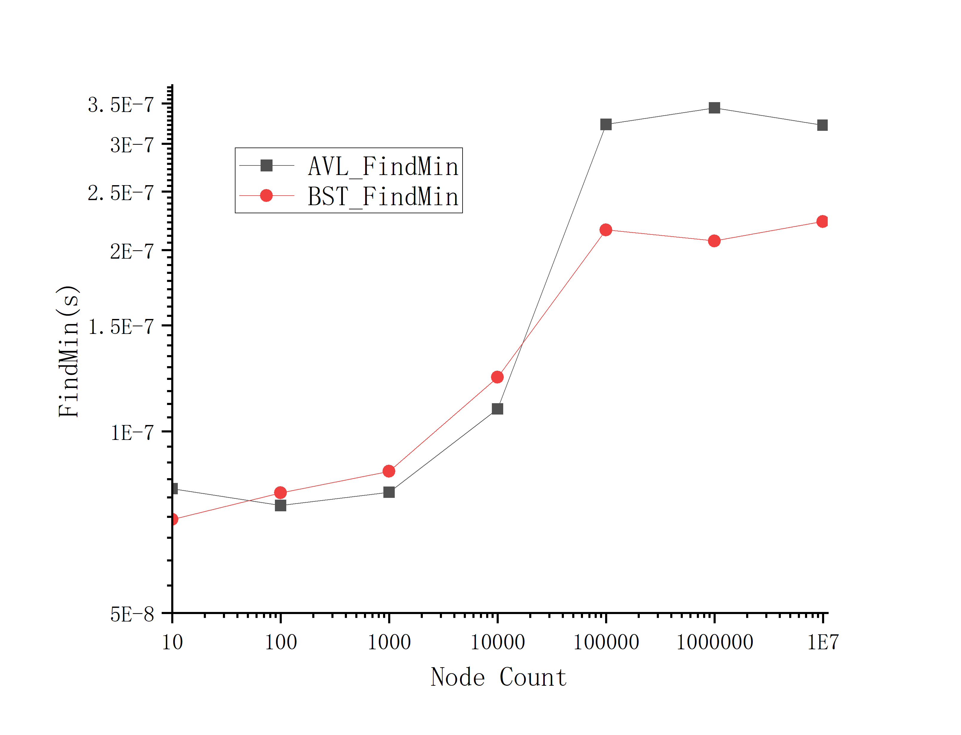
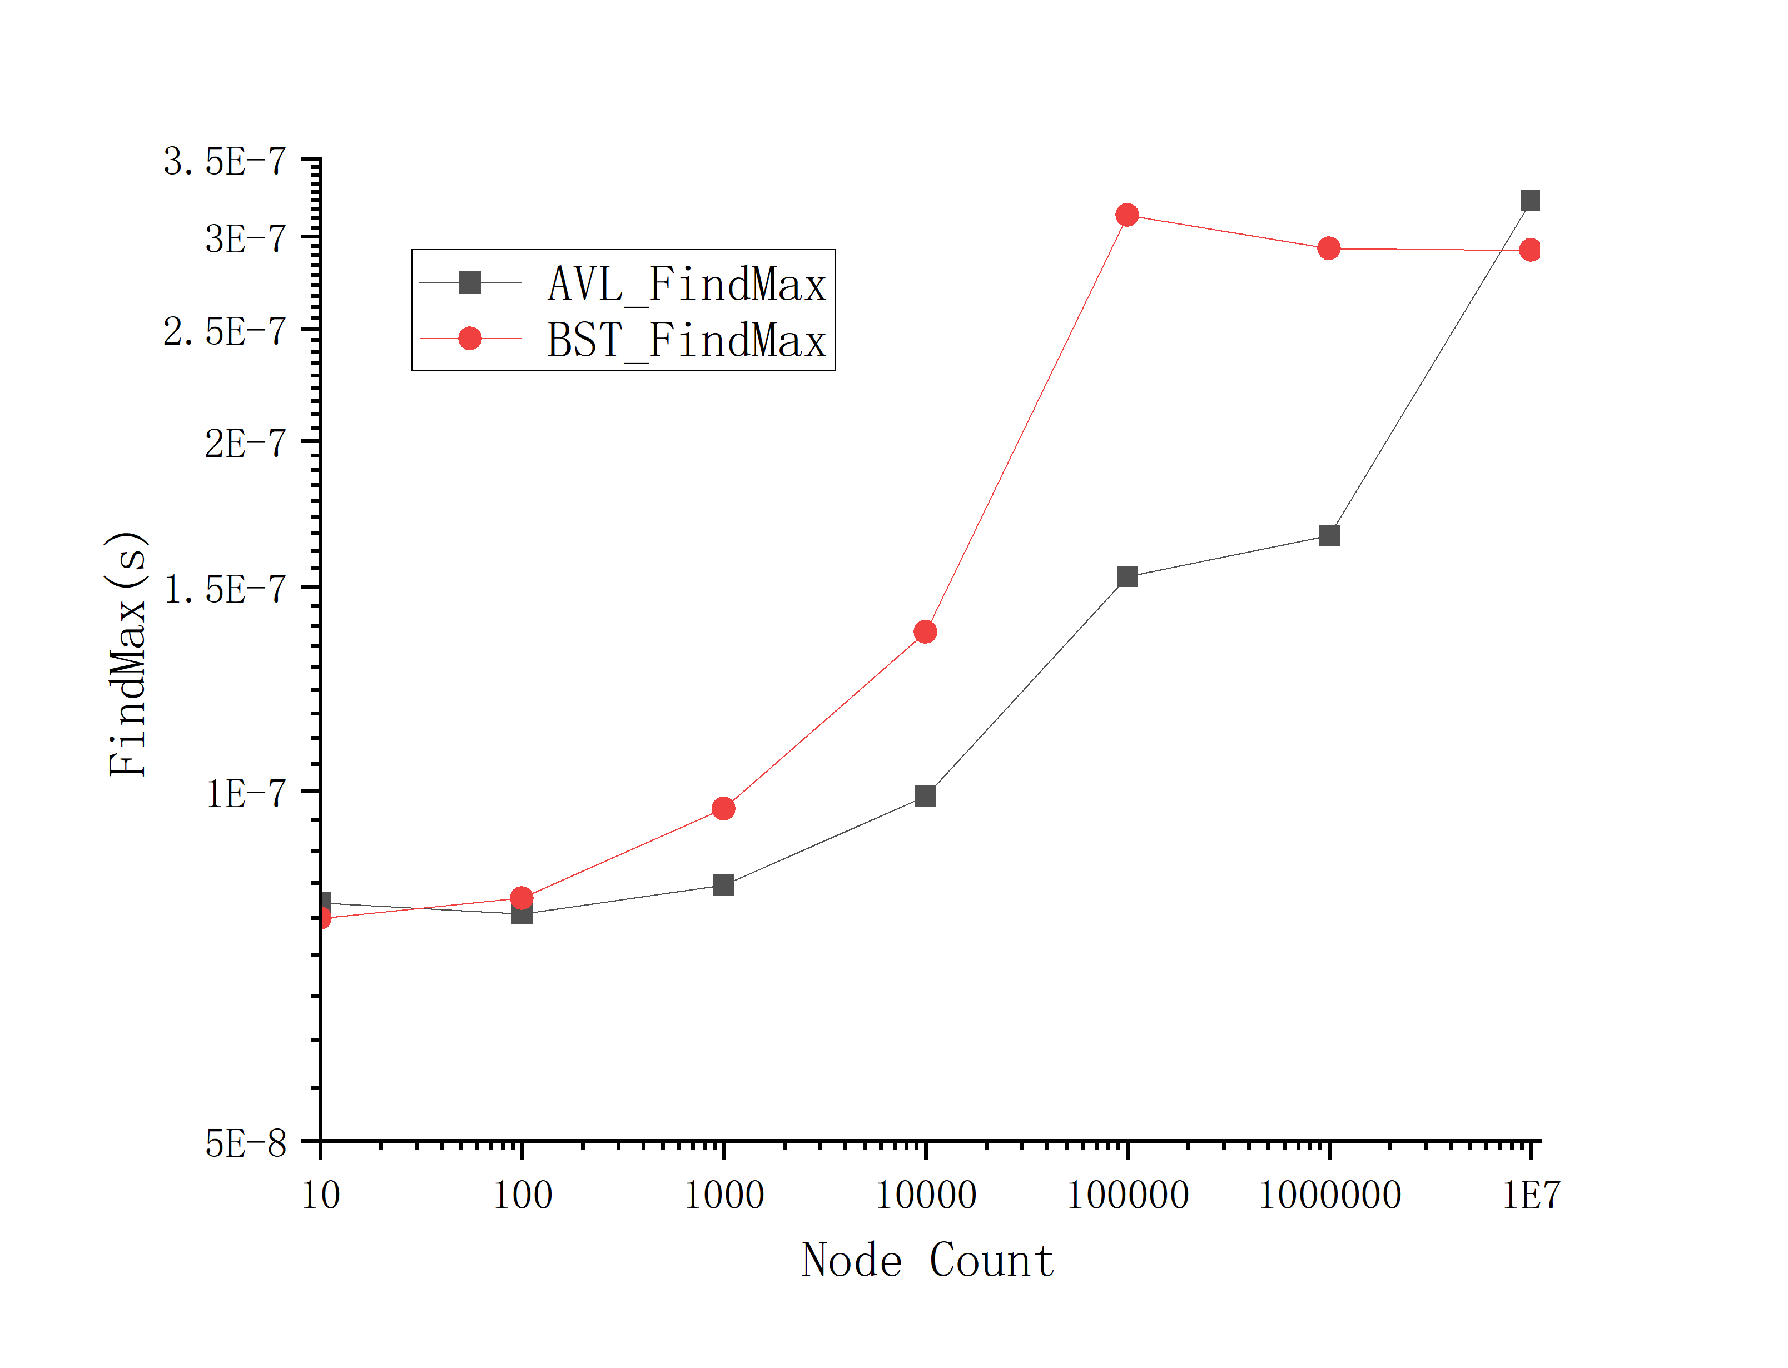
Result
Efficiency Comparison

Slide 18
Analysis
Efficiency Comparison
Building: 10~10000, AVL faster; >10000, RB Tree faster;
Searching: Abnormal decline observed in 10~100, possibly because not all the cores are occupied.
For whole data scale, AVL faster;
Find_min: For the whole data scale, RBTree faster;
Find_max: 10~1000,000, AVL faster; 10,000,000, RB Tree faster.

Slide 19
Question
Question Time

Slide 20
Thanks!
Thanks!

